Slide 1

Notes:
Thank you for the time today. This session is about Aptean OEE: a performance monitoring system you can stand up in weeks, with an optional paperless quality layer on the same screens. Its job is simple. Show the plant what is happening while the shift is still running, so losses get found and fixed today instead of explained on Friday.

Slide 2
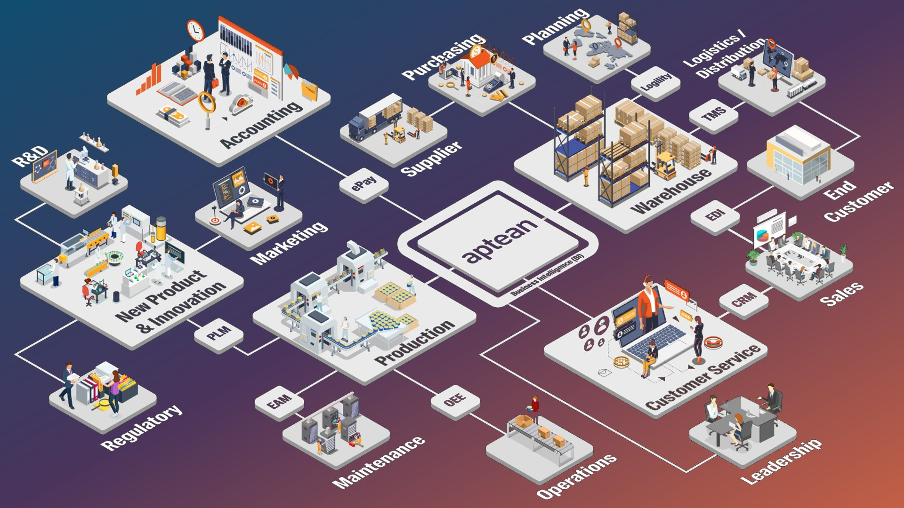
Notes:
Before the detail, here is the map. Aptean ERP and business intelligence sit in the middle, and around them are the products the Beyond ERP team brings to the rest of the business. Every connector on this picture is a product: PLM for new product development, EAM for maintenance, TMS and Logility for logistics and planning, EDI and CRM on the customer side. OEE is the one aimed at the shop floor, between Production and Operations: real-time performance and paperless quality. So today is one piece of a much wider family, and whatever the plant needs next already has a home here.

Slide 3
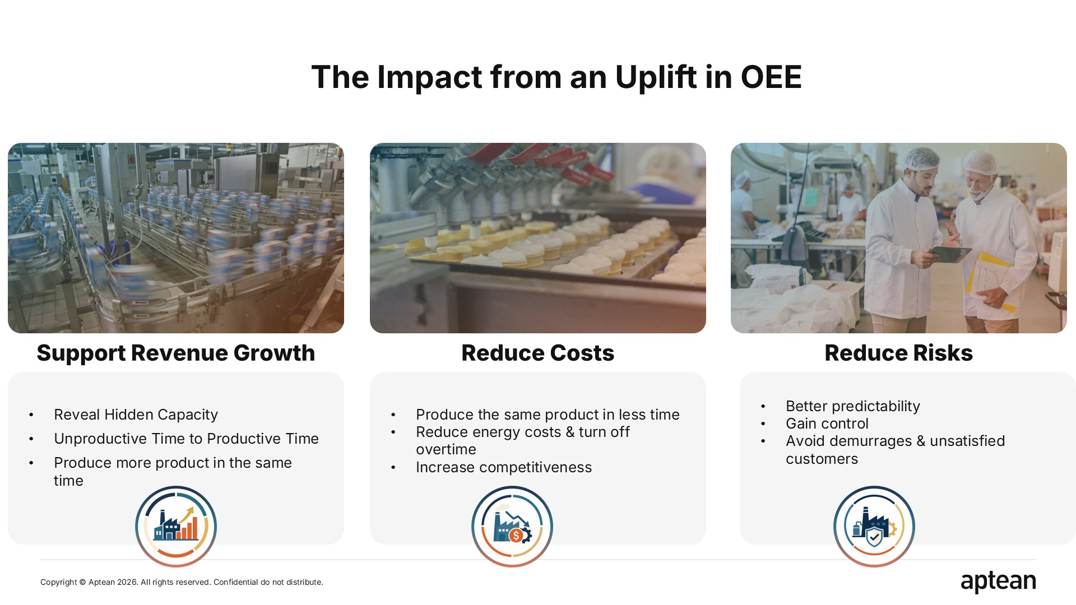
Notes:
Every point of OEE is time: time the plant was scheduled to make good product and did not. Give that time back and it lands in one of three places. Revenue: the same lines make more, so you take extra demand without buying a new line. Cost: the same volume in fewer hours, so overtime and energy come down. Risk: a plant that hits its plan ships on time, avoids penalties and keeps its customers. Almost everyone we work with came in through one of those three doors.

Slide 4
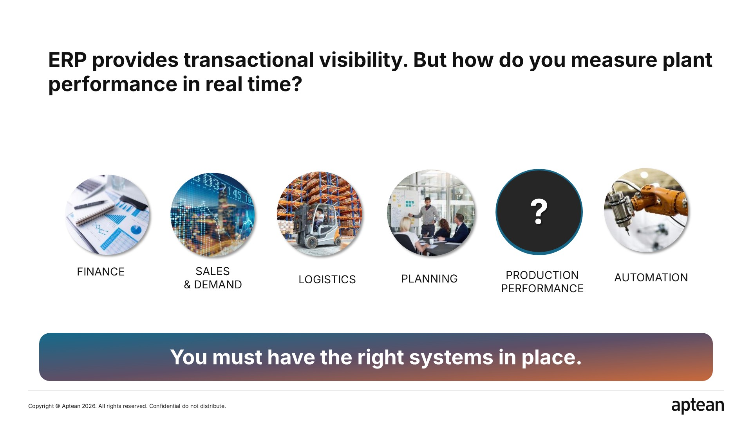
Notes:
Most businesses have invested well upstream. ERP gives you finance, demand, planning and inventory. Then the plan is released to the floor and the picture goes dark. ERP is transactional: it records what was booked, not what is happening. It cannot tell you that a changeover is running long right now, that a line has been slow for twenty minutes, or that this shift will miss the order unless something changes at two o'clock. That gap is where the lost time hides.

Slide 5
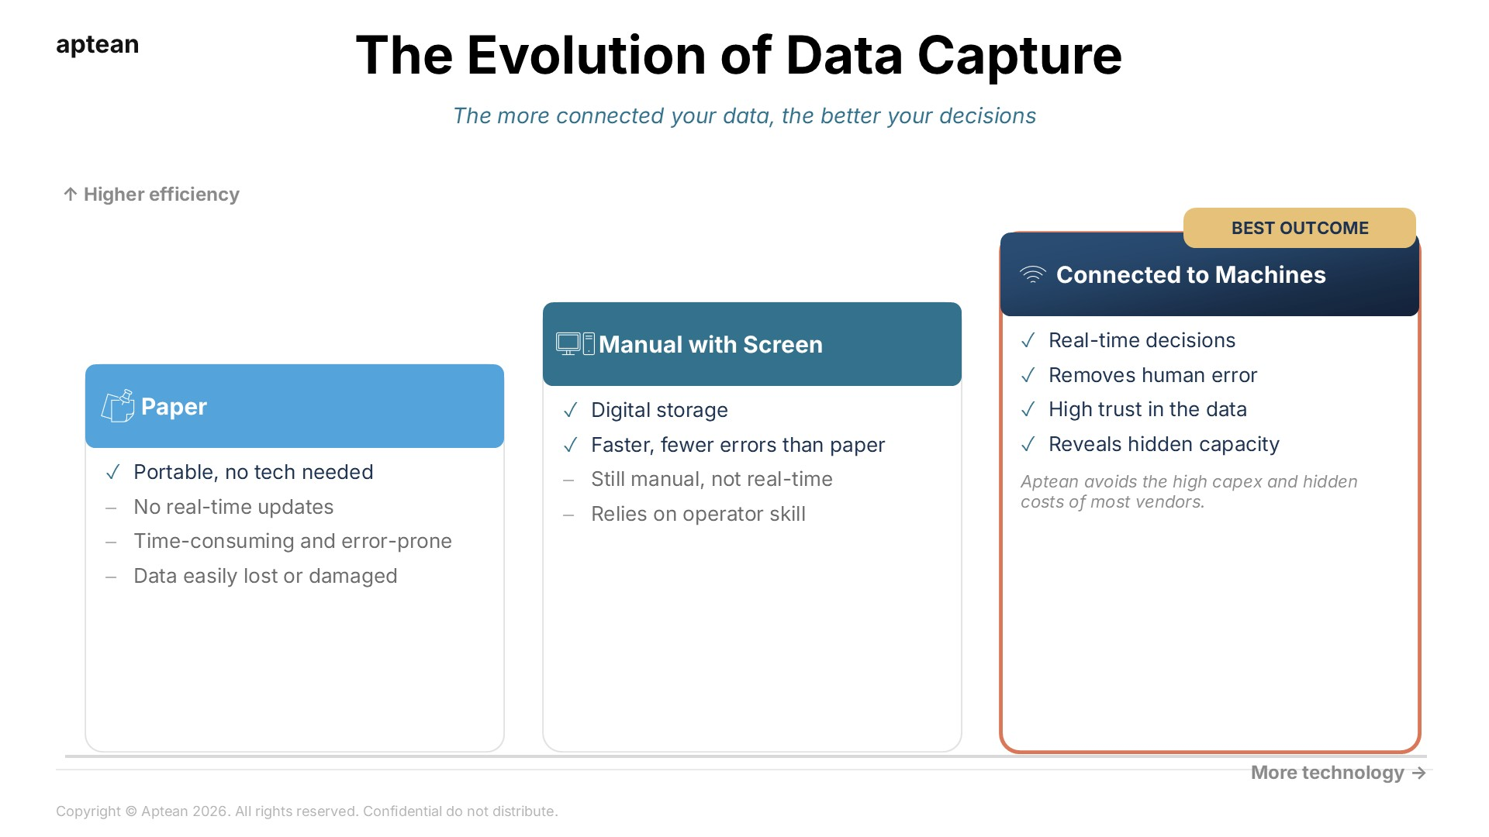
Notes:
Plants sit at different points on this ladder. Paper needs no technology and it travels, but the time stamps are guesses, the double entry into Excel eats a supervisor's day, and nobody trusts the numbers enough to act on them. A screen removes the re-keying and shares the data faster, but it still waits for a person, so it is still not real time and speed loss stays invisible. Connect to the machine and you finally get counts, stops and speed as they happen. That is the only rung where the true losses show up.

Slide 6
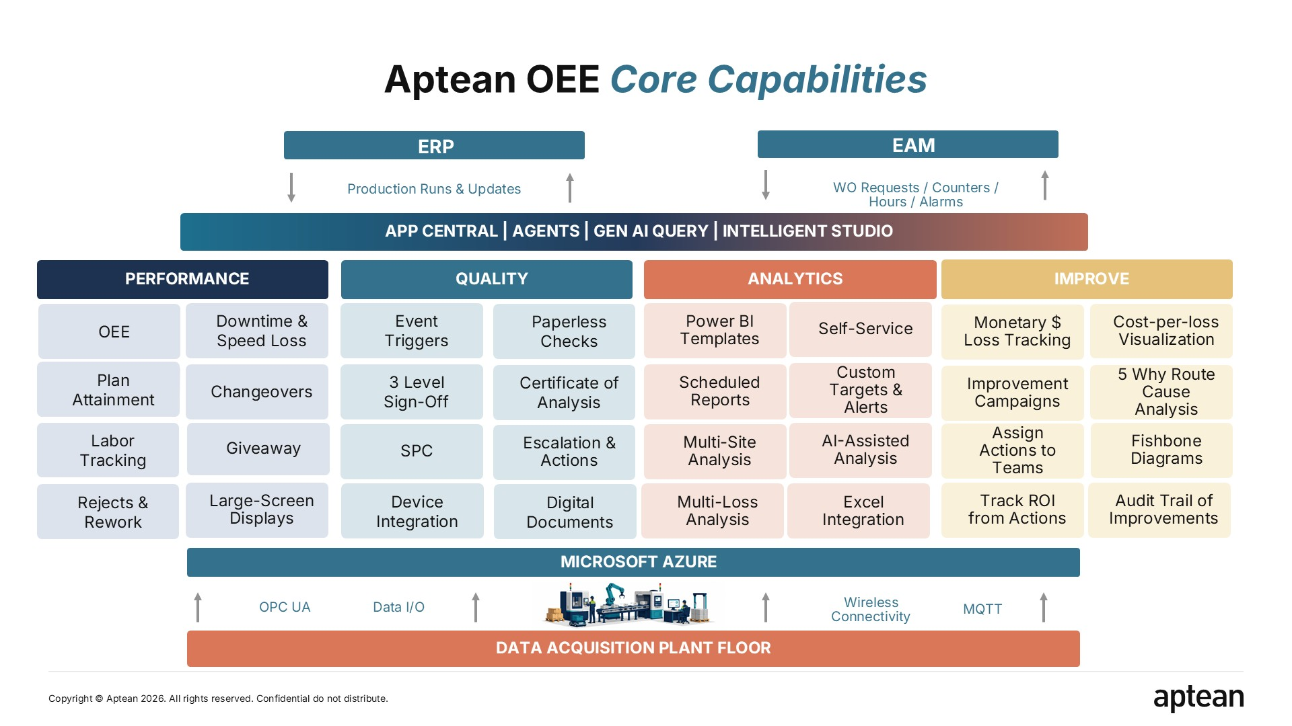
Notes:
We sit between the enterprise layer and the automation. Counts, stops and run data come up from the line; plan attainment goes out to everyone, live. The product is modular. Performance is where most plants start: OEE by line, shift, crew, product and run, with dashboards built to spot the problem now rather than report it later. Quality adds paperless checks, SPC, escalations, three-level sign-off and a certificate of analysis. Analytics puts all of it in Power BI. Improve turns a loss into a campaign with owners and actions.

Slide 7
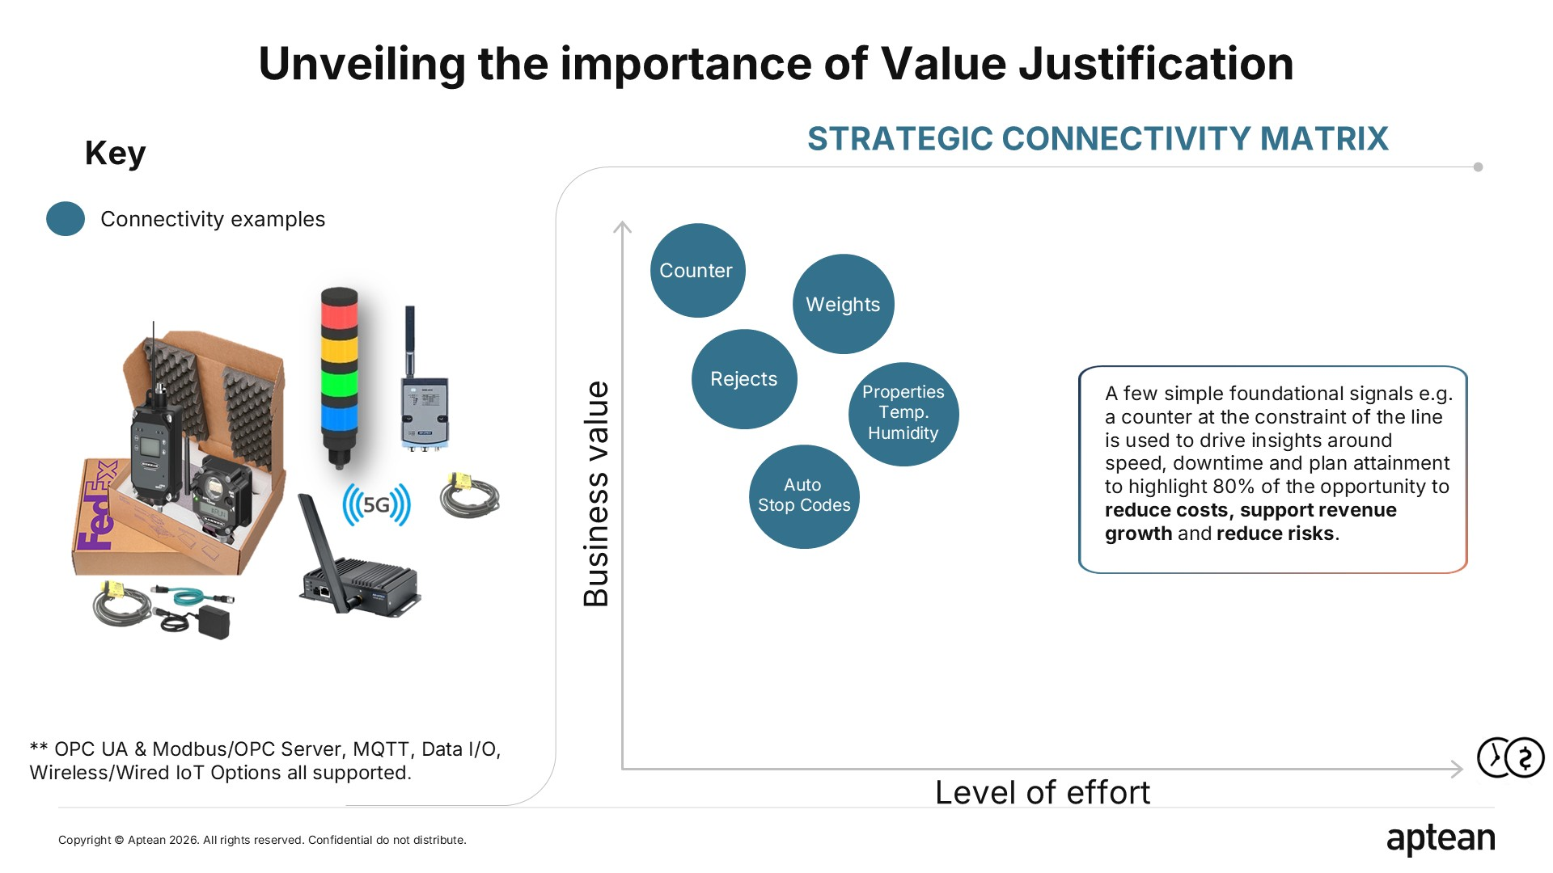
Notes:
This is where we differ from most vendors. We did not start from 'connect everything'; we started from which metrics actually drive improvement and which signals you need for them. The answer is smaller than people expect: a single counter at the constraint of each line. From counts per minute we know the speed against the standard, from gaps in the counts we know every stop, and from the total we know plan attainment. That one signal exposes around eighty percent of the opportunity. Rejects from check weighers, metal detectors and the rest can follow when it suits you.

Slide 8
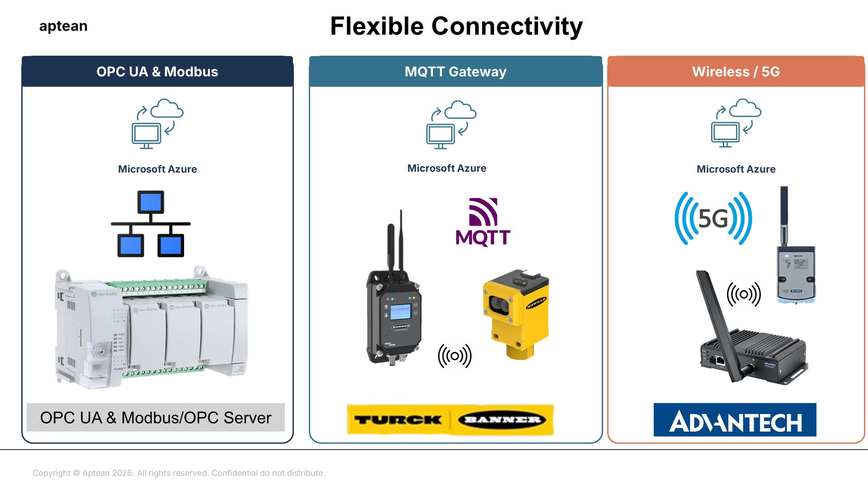
Notes:
How the signal reaches us is your choice. If the PLC data is already on the network we use OPC UA or Modbus through an OPC server. If you want a lighter route, an MQTT gateway. And for older equipment or lines where nothing is networked we ship a wireless kit: a receiver you power up and sensors you drop on the line. Most plants mix the options, and either way the platform runs in Azure.

Slide 9
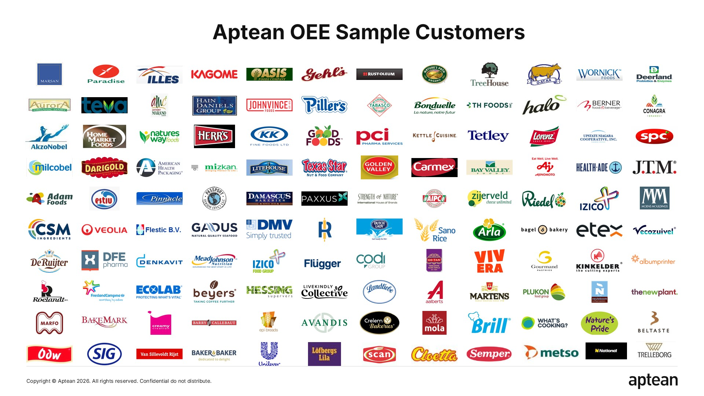
Notes:
You will recognise some of these names. The heartland is food and beverage: bakeries, dairies, snacks, plant-based and fresh produce, with plenty of discrete manufacturing alongside. Deployments range from five lines at one site to more than a hundred lines across several countries, where OEE has become the standard the whole network reports on.

Slide 10
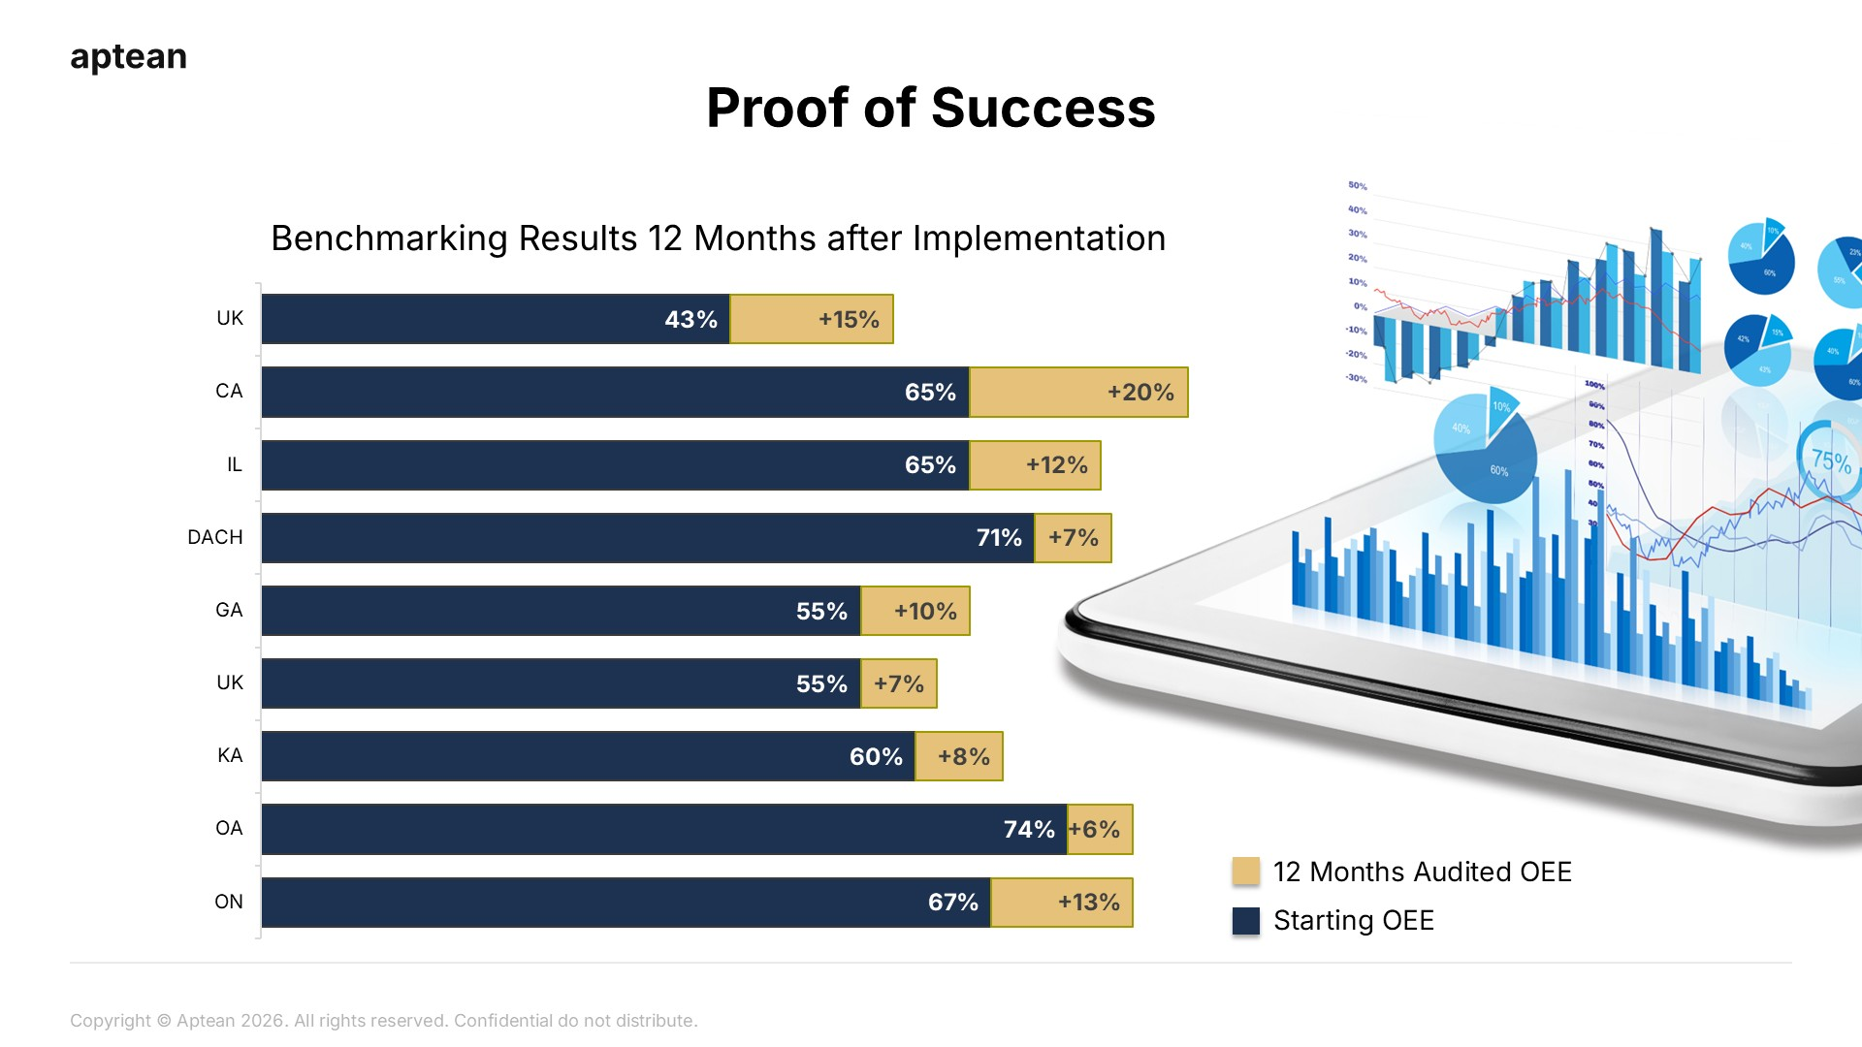
Notes:
These are audited results. We took the management reports customers agreed to share, compared OEE at go-live with OEE twelve months later, and this is the spread: between five and twenty points, about ten on average, with full return on the investment inside eight months in most cases. On a high-speed line a single point is capacity you do not have to buy.

Slide 11
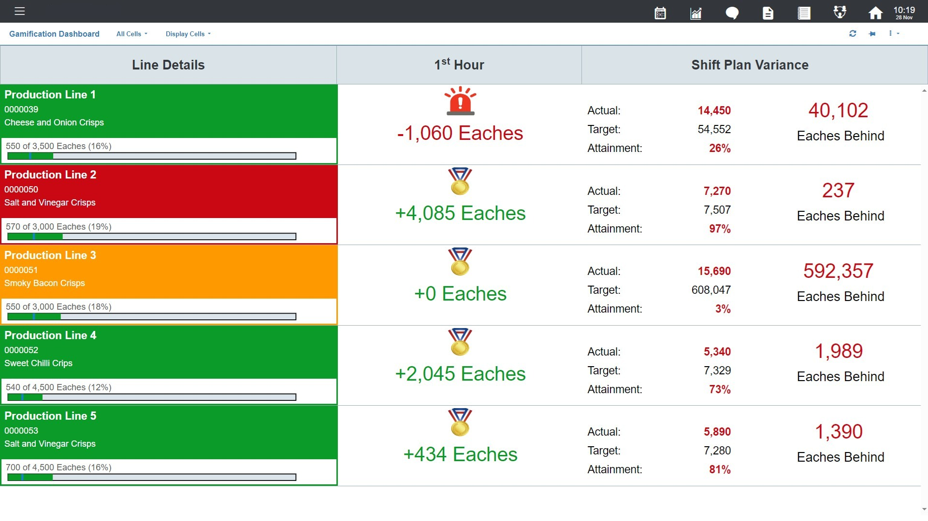
Notes:
This is an example customers put on a television at the end of the line and in the break room. Every line, live: the product, how far through the run, whether the first hour beat or missed its target, and the shift plan variance in units. The incoming shift walks past this on the way to lunch and sees how every line is doing. Engagement without another meeting.

Slide 12
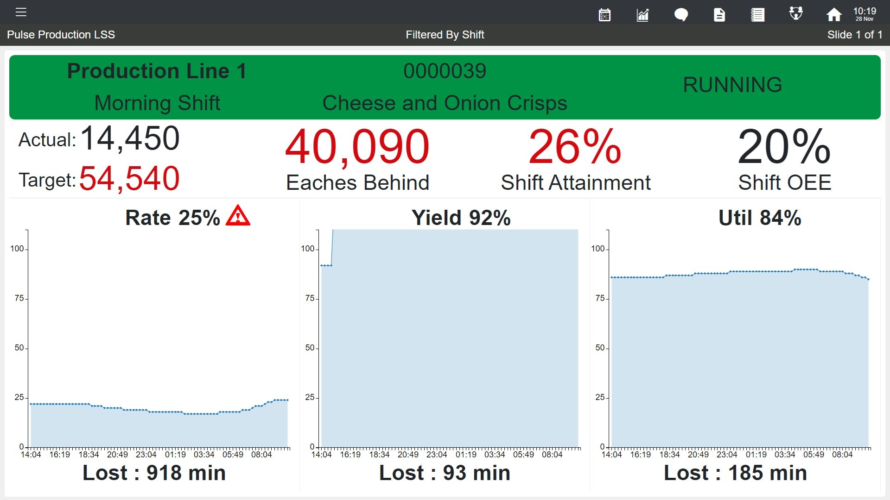
Notes:
One line, one shift, one glance. Actual against target, units behind, attainment and OEE for the shift so far, then the three levers underneath: rate, yield and utilisation trended through the shift, each with the minutes it has cost. When rate is at twenty-five percent and has cost nine hundred minutes, nobody needs a meeting to know where to look.

Slide 13
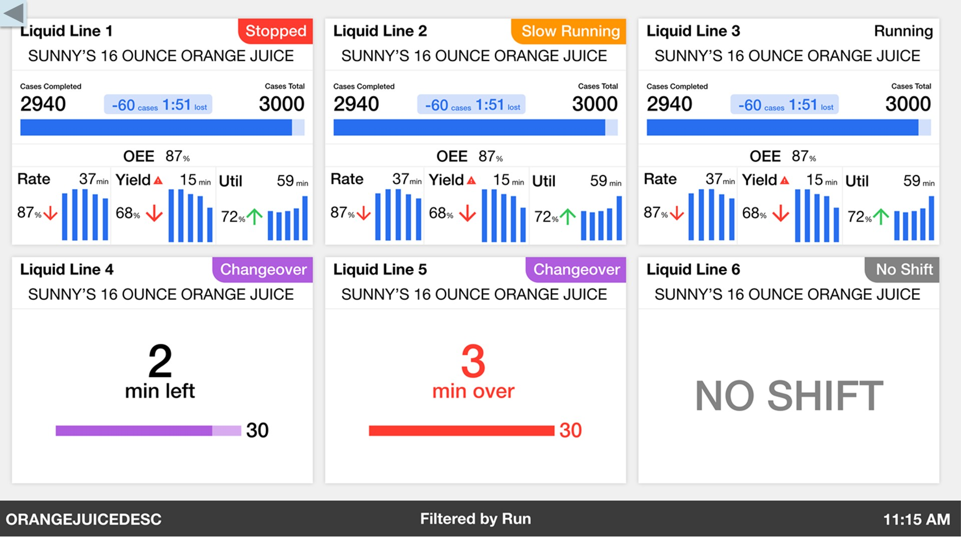
Notes:
A plant view built for process and filling lines alike. Each tile shows the line, its state, the run, cases completed against the total and the minutes lost, then rate, yield and utilisation with their trends. Changeovers count down against their target, so an overrun turns red the moment it happens. A line with no shift says so, rather than quietly reporting zero.

Slide 14
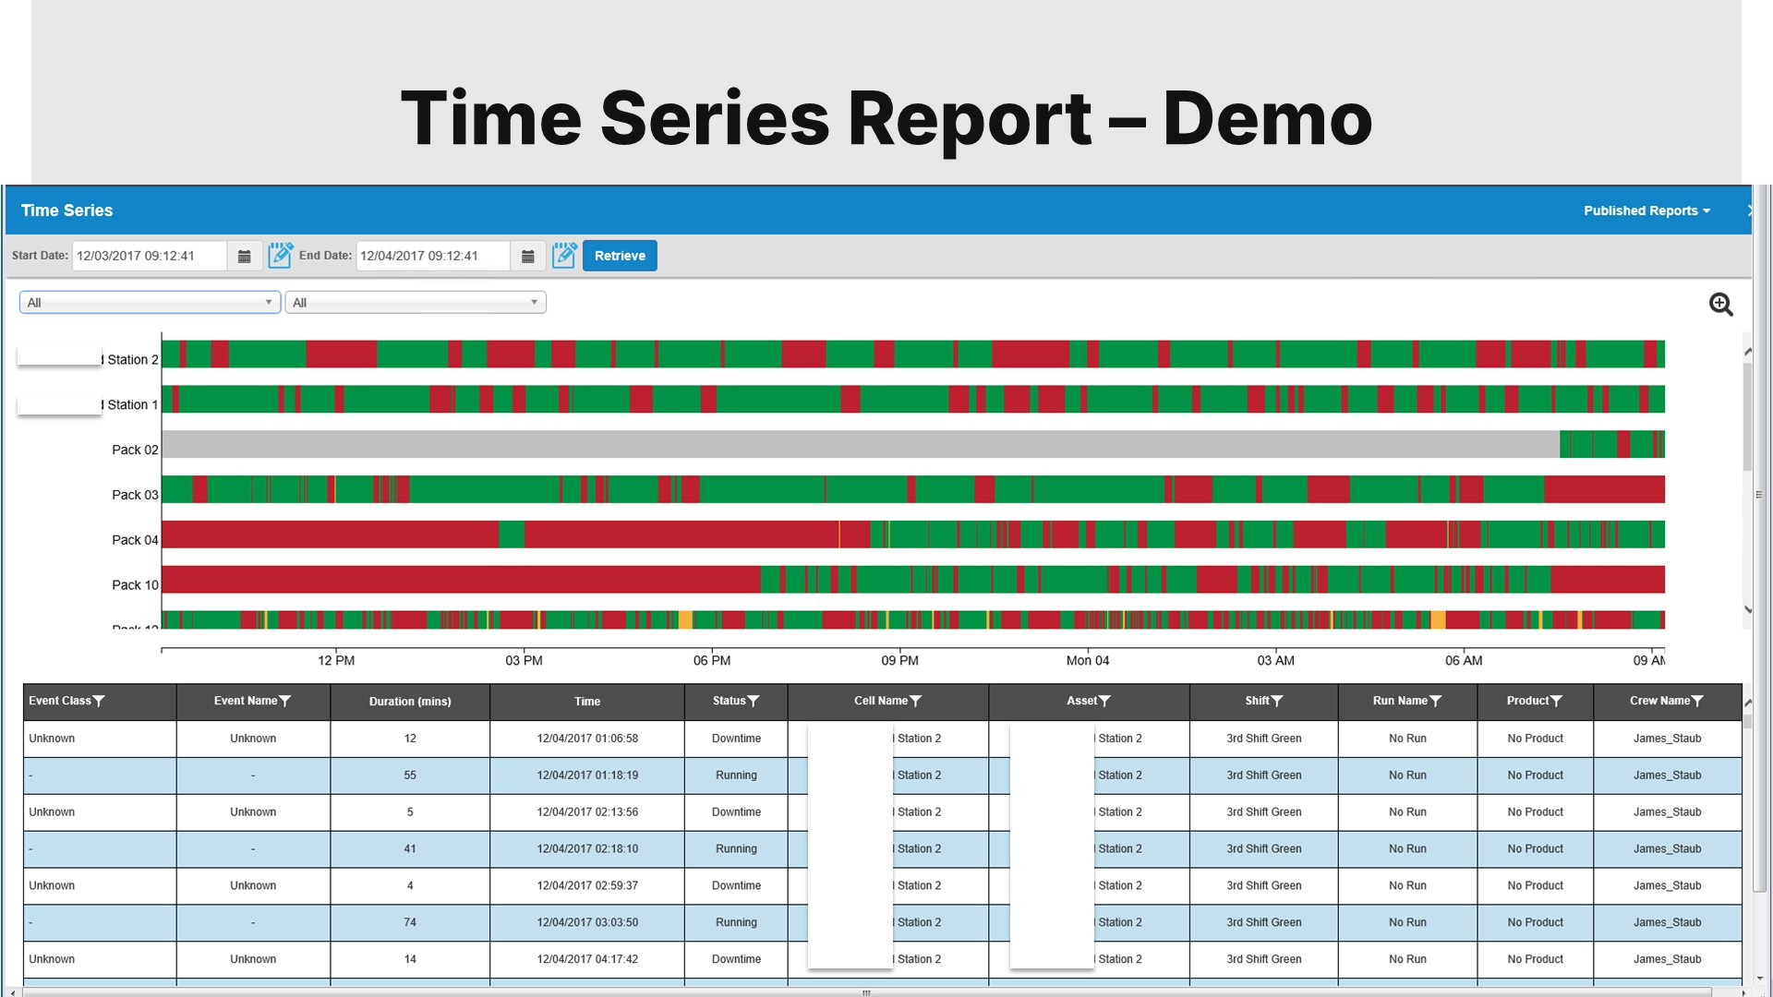
Notes:
Underneath every dashboard is the event record. The time series shows each cell running, stopped or slow across the day, and the table lists every event: when it started, how long it lasted, the reason, the asset, the shift, the run, the product and the crew. This is the audit trail behind the numbers, and it is what analytics and Power BI report from.

